Slide 1

Forecast Analysis on Superstore Data
By K. Siva Naga Lakshmi
(G01099587)

Slide 2
Contents
Introduction
Dataset
Data Preprocessing
Visualization
Forecasting with ARIMA
Conclusion

Slide 3
Introduction
What is forecast Analysis?
Time series data
ARIMA model
Validating Forecast
Forecast Visualization

Slide 4
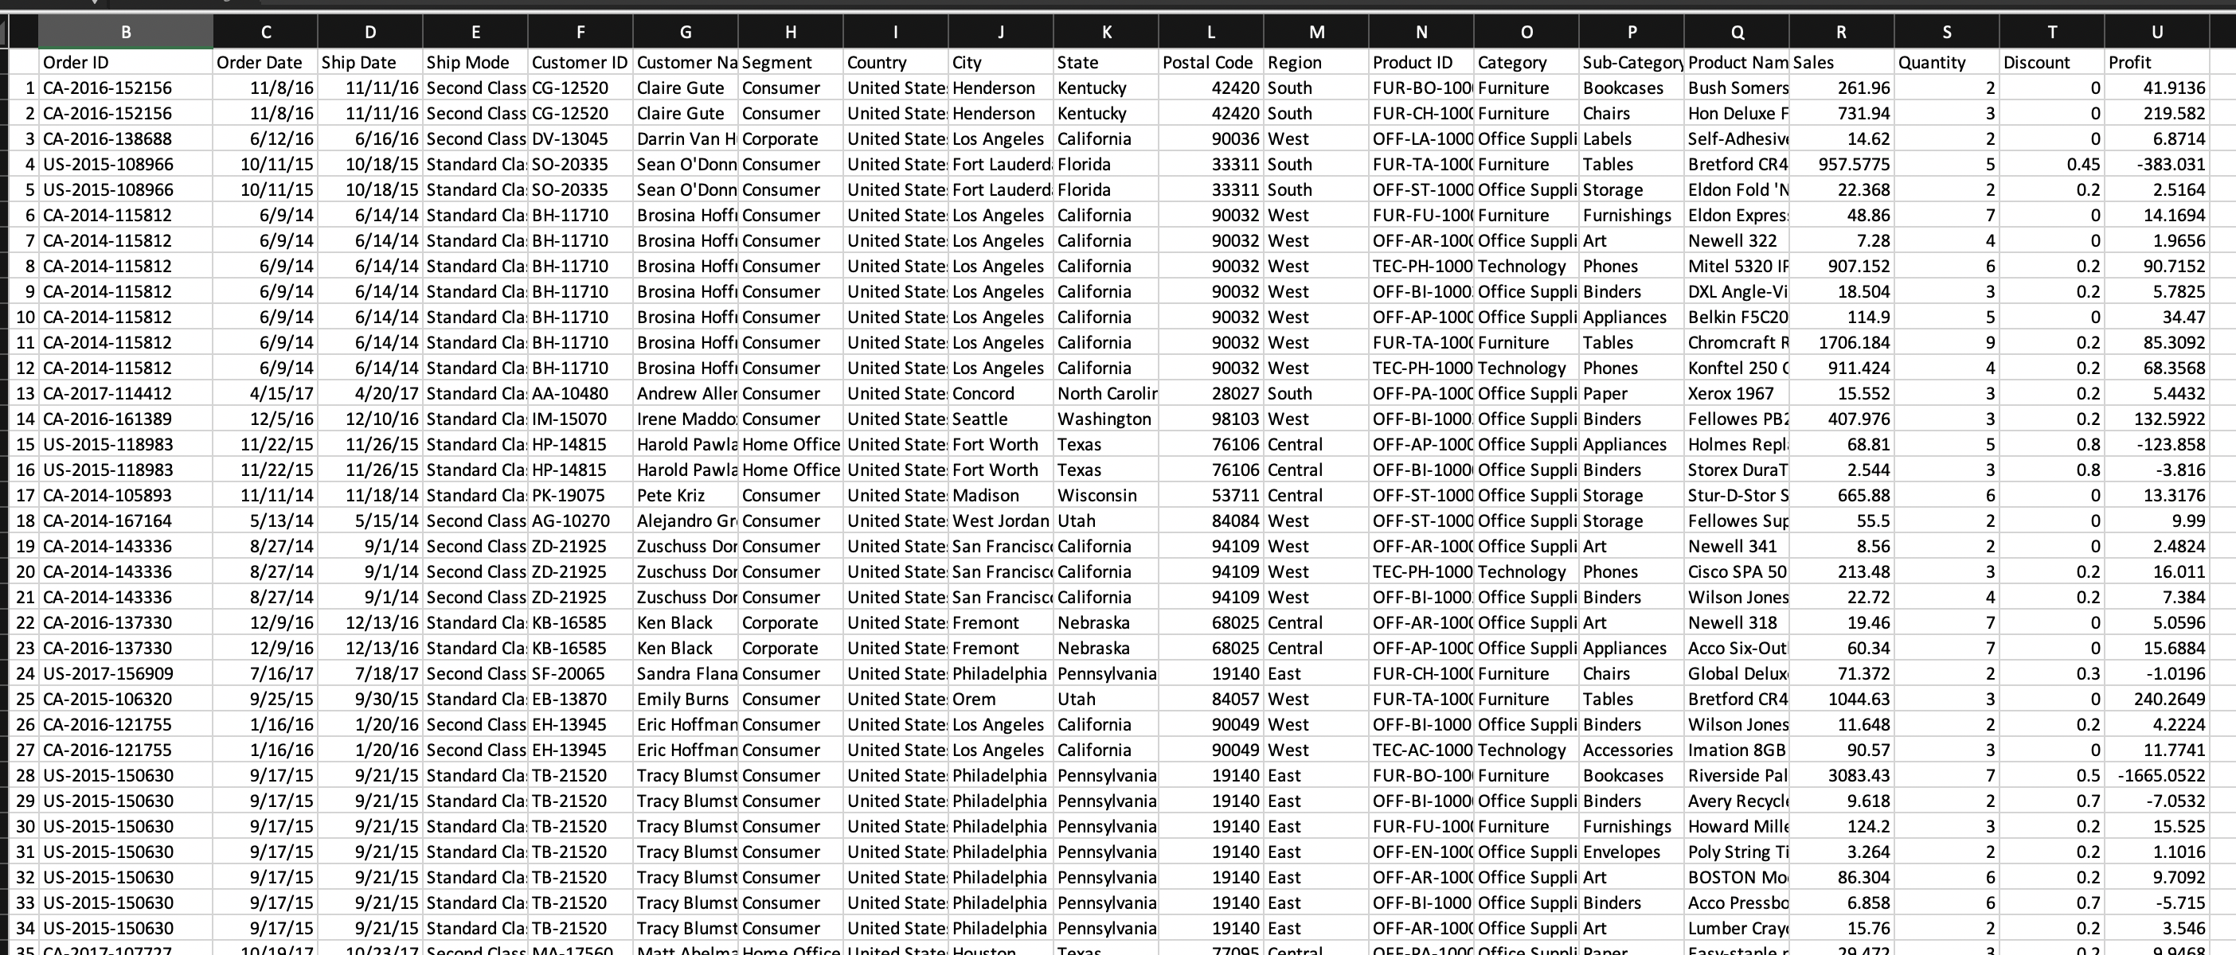
Dataset

Slide 5

Data Preprocessing
Removes columns which are not needed.
Checks for missing values.
Indexing the time series data - start of each month is used as time stamp.

Slide 6
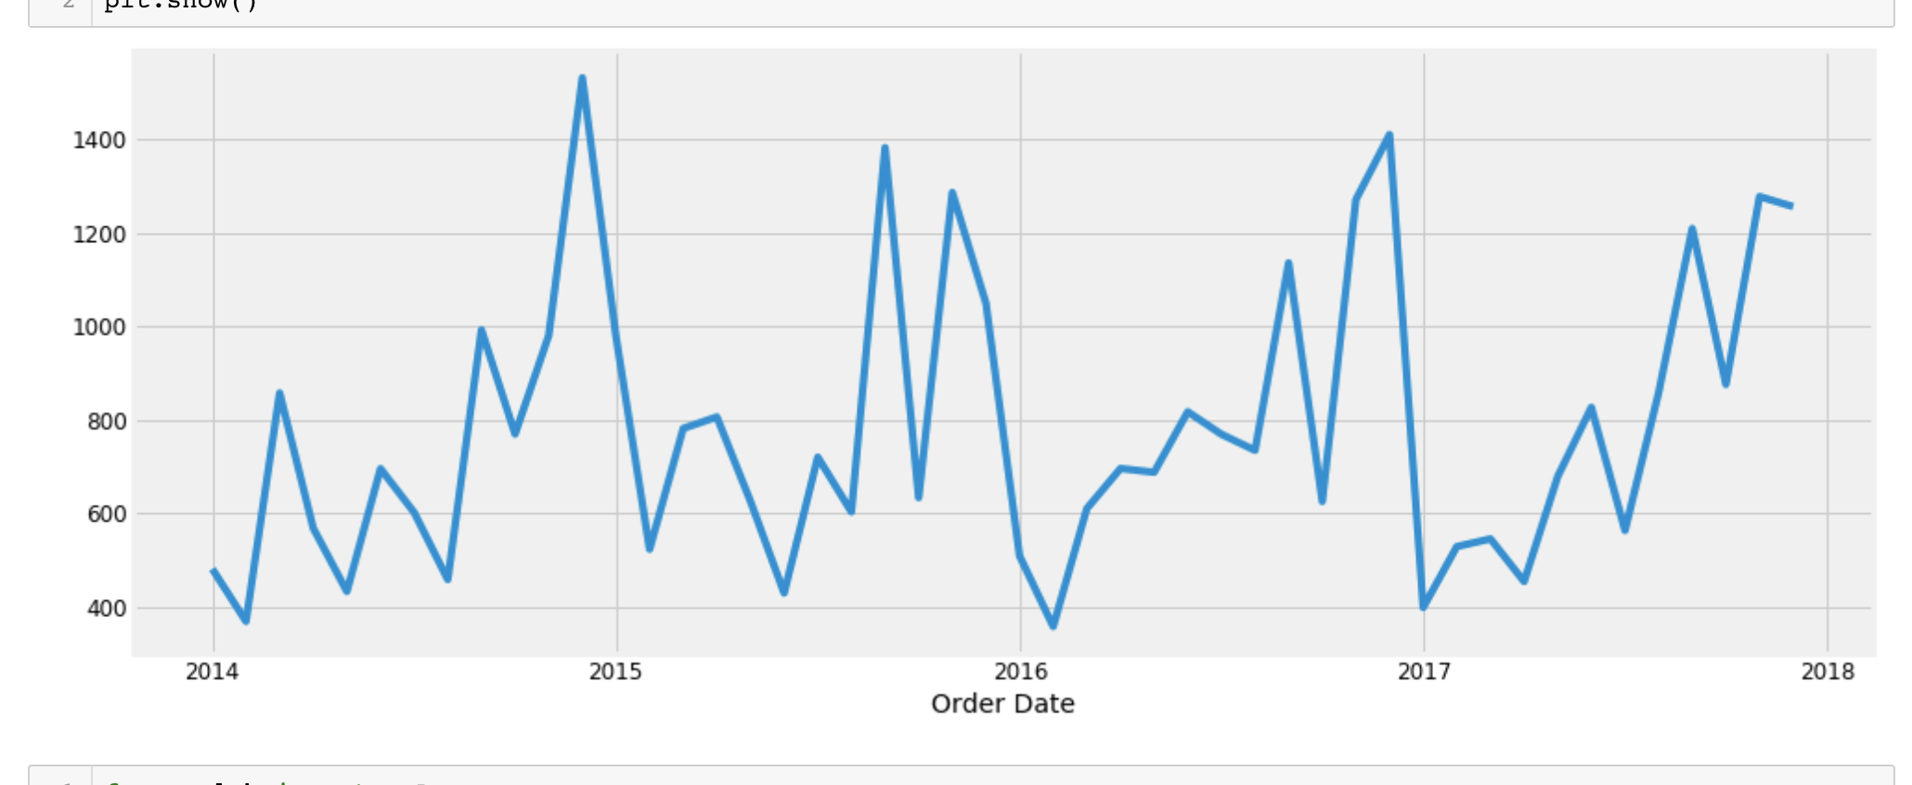
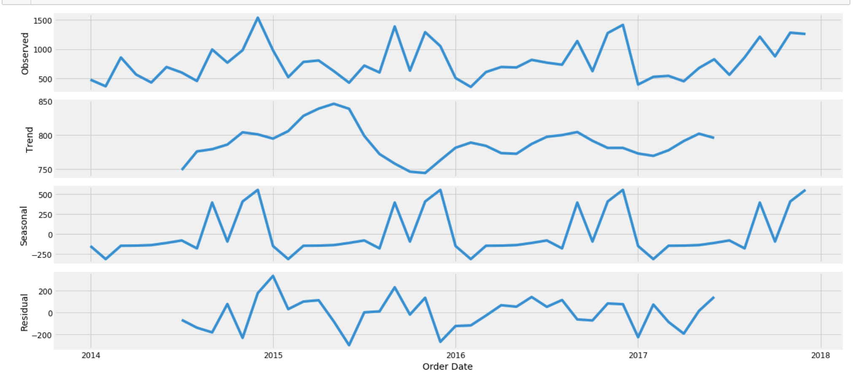
Visualization
Notes:
Left graph depict visualization for the furniture data, and right side graph depicts the decomposition technique.

Slide 7
ARIMA
Stands for Autoregressive Integrated Moving Average
Used to fit the time-series data, to understand and to predict the future values.
Can be applied more than once to remove non-stationarity in data.
Model denoted with notation ARIMA(p, d, q).
Parameters stands for seasonality, trend and noise.
Parameters are selected using grid search.

Slide 8
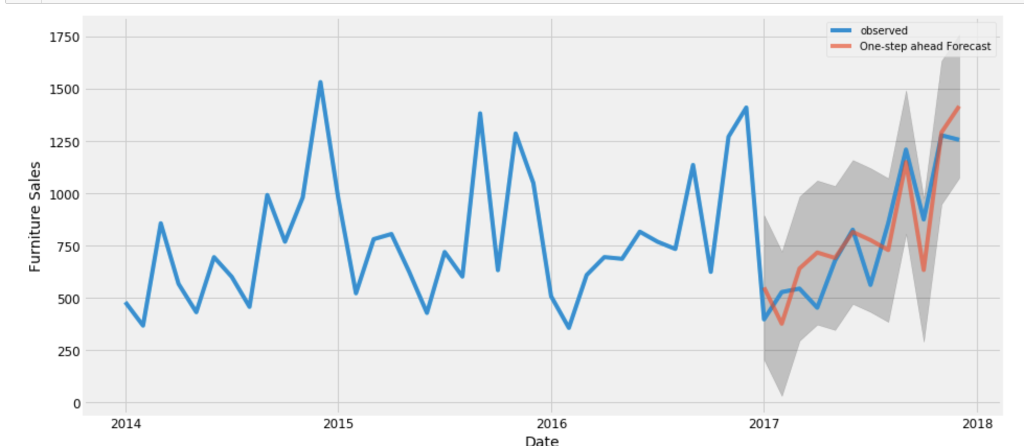
Validating Forecasts
Comparing the predicting sales to the real sales.
Mean square error and root mean square is calculated.

Slide 9
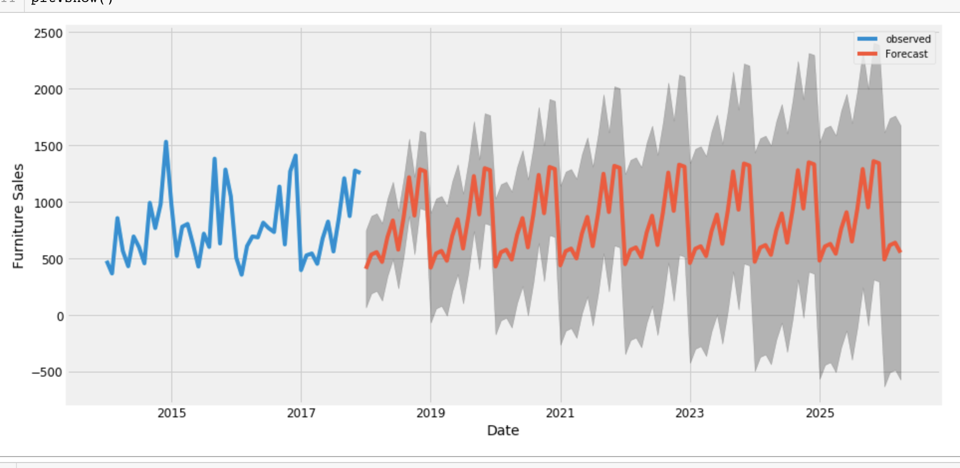
Forecast Visuals

Slide 10


Conclusion
Model has captured the furniture sales seasonality.
Worst sales for furniture is in the month of April.
Notes:
The model has measured better seasonality by the end of the year and April was the worst month for the furniture sales. For future we can compare the different product categories like office supplies and furniture and combine both of them and perform a forecast trend.

